Slide 1
HS 200: Environment Studies
SOCIAL ISSUES AND THE ENVIRONMENT
D.Parthasarathy
India Value Fund Chair Professor, Department of Humanities and Social Sciences
Associate Faculty and Convener, Centre for Excellence in Climate Studies
Associate Faculty, Centre for Policy Studies
Indian Institute of Technology Bombay
Email: ben.dp@iitb.ac.in; dp@hss.iitb.ac.in

Slide 2
What does a social science perspective on environment offer?
Why are nature and the environment social science issues?
Our perceptions of nature are shaped by society and culture (meanings and beliefs).
Our responses to environmental problems depend upon social
structures and relationships (power and institutions).
Human societies are ultimately dependent upon natural life-support systems (the global eco-system or ‘bio-sphere’).
Our social organisation is shaped by our material interventions into nature (labour and technology).

Slide 3
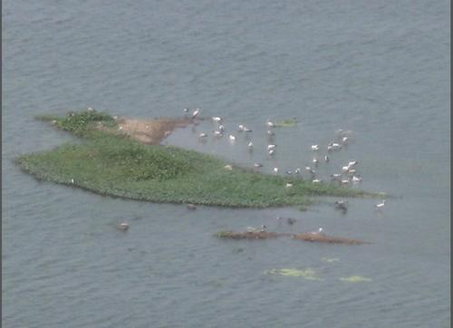
What is nature?
How do we think of nature? How can we think of human-nature relationships? In what ways have human beings changed, evolved, and adapted because of the need to cope with nature?
Is nature socially constructed? Are nature and society separate entities? How do we define, categorize, classify, or understand natural objects?
Nature: Physical or cultural?
Social, cultural, economic, or political context of our understanding or perception

Slide 4
Environmental issues and social science perspectives: Key aspects for the Indian Context
Conflicts and struggles
Access
Equity
Justice
Institutions
Governance
Adverse Impacts

Slide 5
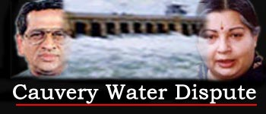
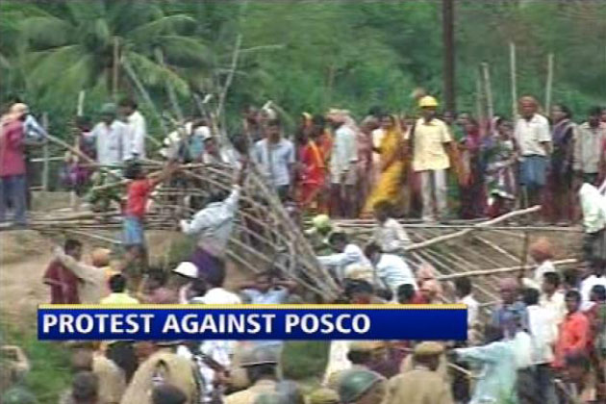
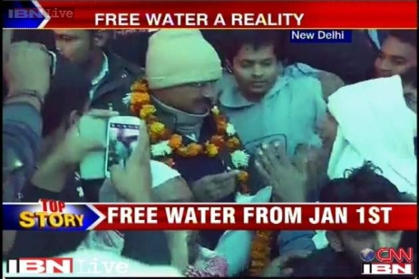
Not Conservation or Protection but social conflicts around natural resources as the central environmental problem: Ramachandra Guha and Madhav Gadgil
Who owns resources?
Who should own them?
Who should manage resources?
What technologies should be used?

Slide 6
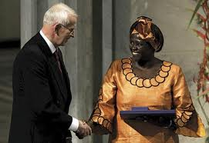
Wangari Maathai
2004: First African woman to receive the Nobel Peace Prize for "her contribution to sustainable development, democracy and peace."
Wangari Maathai & The Green Belt Movement: http://www.youtube.com/watch?v=BQU7JOxkGvo

Slide 7
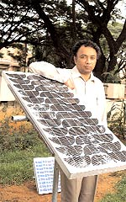
Harish Hande
2011: awarded Ramon Magsaysay award for “his pragmatic efforts to put solar power technology in the hands of the poor, through his social enterprise SELCO India”
Harish Hande - Selco Solar - Solar lights in villages: http://www.youtube.com/watch?v=GsPFkMu5PJE

Slide 8
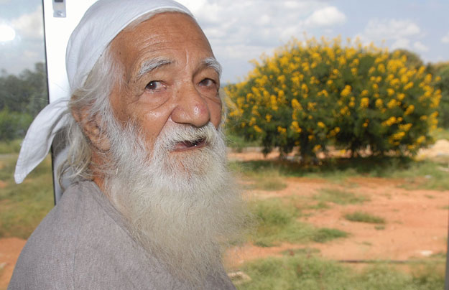
Sunderlal Bahuguna
Padma Vibhushan, Right Livelihood Award
In Conversation: Sunderlal Bahuguna with Dr. George A. James
https://www.youtube.com/watch?v=cwTXBPwObko

Slide 9
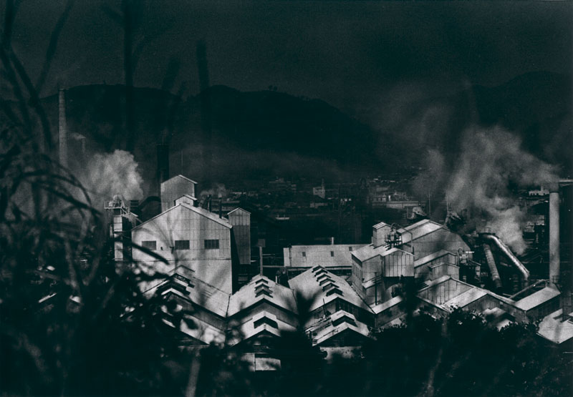
Minamata
Large scale effects of industrial pollution: mercury poisoning
Mercury Poisoning- The Minamata Story: http://www.youtube.com/watch?v=ihFkyPv1jtU

Slide 10

Rachel Carson – Silent Spring
Environmental and health consequences of chemical intensive agriculture
Endosulfan poisoning in Kerala

Slide 11
Understanding environmental issues: Addressing ecological, socio-cultural, economic concerns
Cups: Plastic, Styrofoam, paper, or clay / ceramic?
Plastics or Natural?
Chemical or Organic?
Fossil Fuels or bio-fuels?
What is eco-friendly / environment friendly? Think Critically

Slide 12
FROM UNSUSTAINABLE TO SUSTAINABLE DEVELOPMENT
Solutions to problems? Choice of Technologies? Lifestyles? Philosophy? Ethics? Attitudes? Economic models? Prevention?
How much should we consume? (Ramachandra Guha)
What is sustainability about?
Ecology and Equity: Ramachandra Guha and Madhav Gadgil
When can we be sustainable? How can we lead sustainable lives? What changes at which levels?

Slide 13
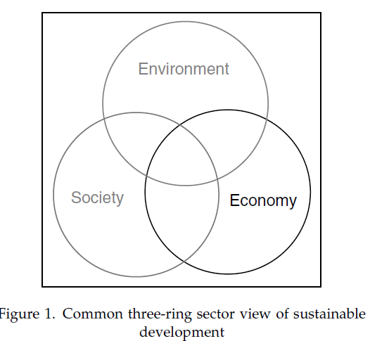
Source: Bob Giddings, Bill Hopwood, and Geoff O’Brien, Sust. Dev. 10, 187–196 (2002)

Slide 14
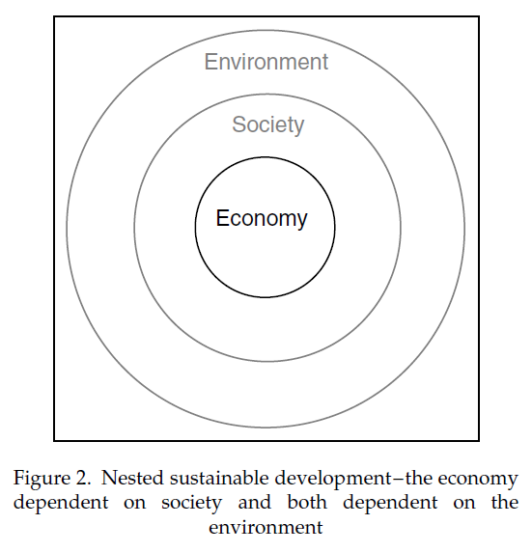
Stocks and Flows
Source: Bob Giddings, Bill Hopwood, and Geoff O’Brien, Sust. Dev. 10, 187–196 (2002)

